Slide 1
LAN Connections
Configuring a Cisco Router

Slide 2
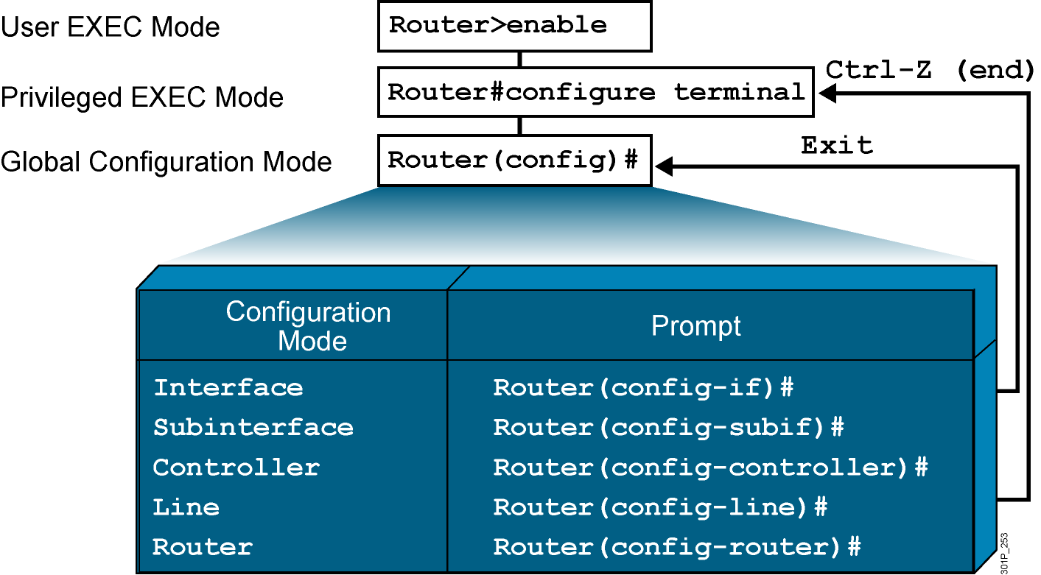
Overview of Router Modes
Notes:
Emphasize: Here is a list of some of the configuration modes available.
For a complete list of the router configuration modes, refer to the Cisco Documentation CD-ROM.

Slide 3
Saving Configurations
RouterX#
RouterX#copy running-config startup-config
Destination filename [startup-config]?
Building configuration…
RourterX#
Copies the current configuration to NVRAM
Notes:
Emphasize: Copying to NVRAM overwrites the contents in NVRAM.

Slide 4
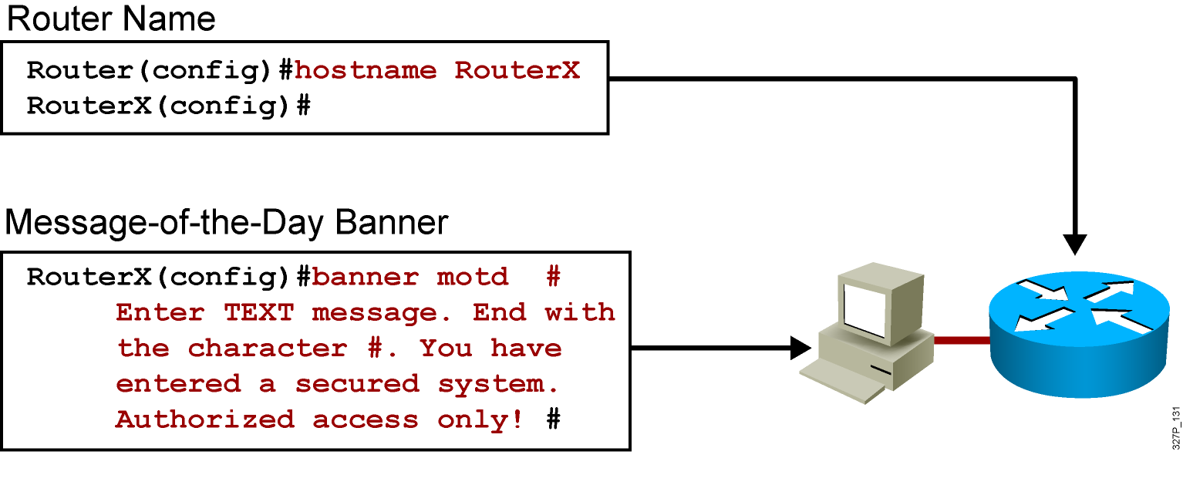
Configuring Router Identification
Notes:
Slide 2 of 2
Emphasize: Layer 2—The interface description command allows you to enter a one-line descriptive statement for each interface. This description is displayed in the output from the show interfaces command and appears in the show running-config and show startup-config listings.

Slide 5
Console-Line Commands
RouterX(config)#line console 0
RouterX(config-line)#exec-timeout 20 30
  Modifies console session timeout
RouterX(config)#line console 0
RouterX(config-line)#logging synchronous
  Redisplays interrupted console input
Notes:
Emphasize: If the student enters no exec by mistake, the console port EXEC mode will be disabled once the student is logged out of the current session. If this happens, you have to break into the router using ROM monitor to recover (set the config reg to 0x2142 so it will ignore NVRAM).

Slide 6
Configuring an Interface
RouterX(config)#interface type number
RouterX(config-if)#
  type includes serial, ethernet, token ring, fddi, hssi, loopback, dialer, null, async, atm, bri, tunnel, and so on
  number is used to identify individual interfaces
RouterX(config)#interface type slot/port
RouterX(config-if)#
  For modular routers, selects an interface
RouterX(config-if)#exit
  Quits from current interface configuration mode
Notes:
Purpose: This slide shows the interface configuration mode.
Emphasize: The top line is the format of the command used in fixed-port routers. The type field shows the interface type, which can be Ethernet, Token Ring, or another interface. The number field is the number of the interface. For example, if the router has two Ethernet interfaces, and one is known as Ethernet0, the other will be called Ethernet1.
The second command is used on the Cisco 7000 and 7200 series routers, which can accept multiple interface cards with multiple ports on each card. In this case, the first number is the number of the card, or slot number. The second number is the port on the card. For example, on the second interface card, the first Ethernet interface is specified as Ethernet 2/0.
If you have Cisco 7000 and 7500 series routers with VIP cards, you define an interface by slot, port adapters, and port numbers. Port adapters are assigned either a 0 or 1 number.
Use the exit command to leave the current configuration mode.

Slide 7
Configuring an Interface Description
RouterX(config-if)# description string
  string is a comment or a description to help you remember what is attached to this interface.
  The maximum number of characters for the string argument is 238.
Notes:
Purpose: This slide shows the interface configuration mode.
Emphasize: The top line is the format of the command used in fixed-port routers. The type field shows the interface type, which can be Ethernet, Token Ring, or another interface. The number field is the number of the interface. For example, if the router has two Ethernet interfaces, and one is known as Ethernet0, the other will be called Ethernet1.
The second command is used on the Cisco 7000 and 7200 series routers, which can accept multiple interface cards with multiple ports on each card. In this case, the first number is the number of the card, or slot number. The second number is the port on the card. For example, on the second interface card, the first Ethernet interface is specified as Ethernet 2/0.
If you have Cisco 7000 and 7500 series routers with VIP cards, you define an interface by slot, port adapters, and port numbers. Port adapters are assigned either a 0 or 1 number.
Use the exit command to leave the current configuration mode.

Slide 8
Disabling or Enabling an Interface
RouterX#configure terminal
RouterX(config)#interface serial 0
RouterX(config-if)#shutdown
%LINK-5-CHANGED: Interface Serial0, changed state to administratively down
%LINEPROTO-5-UPDOWN: Line protocol on Interface Serial0, changed state to down
  Administratively turns off an interface
RouterX#configure terminal
RouterX(config)#interface serial 0
RouterX(config-if)#no shutdown
%LINK-3-UPDOWN: Interface Serial0, changed state to up
%LINEPROTO-5-UPDOWN: Line Protocol on Interface Serial0, changed state to up
  Enables an interface that is administratively shut down
Notes:
Emphasize: The Catalyst 1900 switch also uses the shut and no shut command.

Slide 9
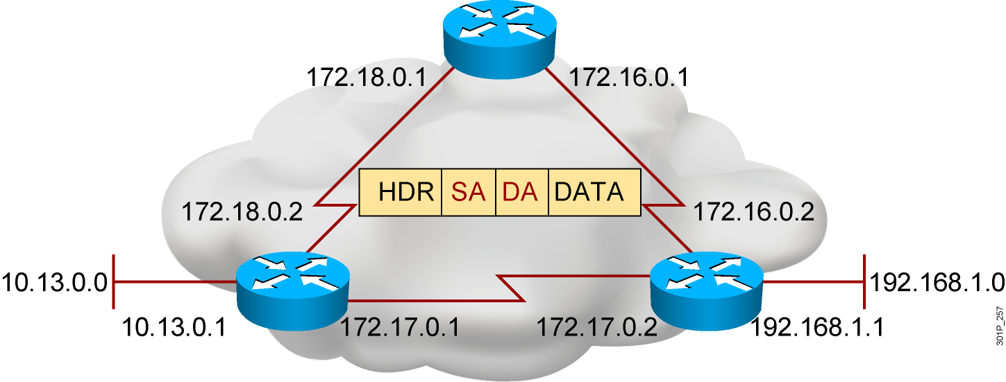
Configuring IP Addresses
  Unique addressing allows communication
  between end stations
  Path choice is based on destination address
Notes:
Purpose: This is an introduction slide to the IP addressing section.
Emphasize: Stations with internetwork access must have unique addresses.

Slide 10
Router show interfaces Command
RouterX#show interfaces
Ethernet0 is up, line protocol is up
Hardware is Lance, address is 00e0.1e5d.ae2f (bia 00e0.1e5d.ae2f)
Internet address is 10.1.1.11/24
MTU 1500 bytes, BW 10000 Kbit, DLY 1000 usec, rely 255/255, load 1/255
Encapsulation ARPA, loopback not set, keepalive set (10 sec)
ARP type: ARPA, ARP Timeout 04:00:00
Last input 00:00:07, output 00:00:08, output hang never
Last clearing of "show interface" counters never
Queueing strategy: fifo
Output queue 0/40, 0 drops; input queue 0/75, 0 drops
5 minute input rate 0 bits/sec, 0 packets/sec
5 minute output rate 0 bits/sec, 0 packets/sec
81833 packets input, 27556491 bytes, 0 no buffer
Received 42308 broadcasts, 0 runts, 0 giants, 0 throttles
1 input errors, 0 CRC, 0 frame, 0 overrun, 1 ignored, 0 abort
0 input packets with dribble condition detected
55794 packets output, 3929696 bytes, 0 underruns
0 output errors, 0 collisions, 1 interface resets
0 babbles, 0 late collision, 4 deferred
0 lost carrier, 0 no carrier
0 output buffer failures, 0 output buffers swapped out
Notes:
Purpose: This slide presents the show interfaces command, which indicates whether the network is operating at the physical and data link layers. The command output is interpreted later in this chapter.
Emphasize: The top line of the output tells us that the line is up. A few lines down, the output provides the IP address, and below that some characteristics like BW for bandwidth, and DLY for delay. On the next line down, we find an encapsulation type of ARPA. ARPA means Ethernet II, which is the default IP encapsulation type for Ethernet interfaces on Cisco routers.
A runt is an Ethernet frame that is too small to be legal (less than 64 bytes), and a giant is an Ethernet frame that is too big (greater than 1518 bytes).

Slide 11
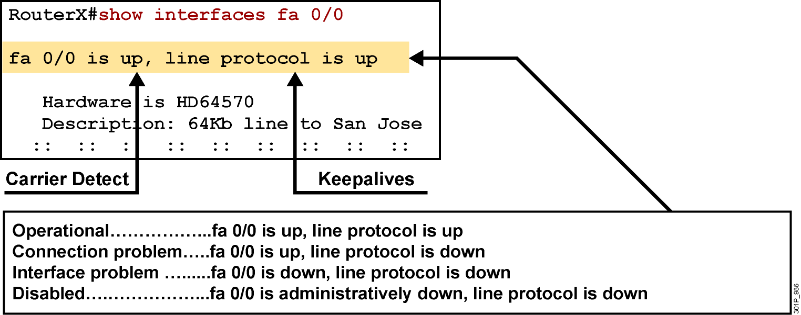
Interpreting the Interface Status
Notes:
Purpose: This slide explains how to interpret the show interfaces serial command output.
Emphasize: The show interfaces serial command output indicates that the serial interface is up and the line protocol is up. The first parameter refers to the hardware layer and essentially reflects whether the interface is receiving the Carrier Detect signal from the other end. The second parameter refers to the data link layer. This parameter reflects whether the data link layer protocol keepalives are being received.
If both the interface and the line protocol are up, the connection is operational.
If the hardware is up and the line protocol is down, a connection problem exist such as no clocking, wrong encapsulation type, or no keepalives.
If both the line protocol and the interface are down, a cable might never have been attached to the router. On the serial cable, you can plug in the cable upside-down, causing the pins on the serial cable to break.
There is one more possibility. If the information says “administratively down,” you have manually disabled (shut) the interface.
Cisco offers a hardware class (IMCR) that discusses the router hardware in more detail.

Slide 12
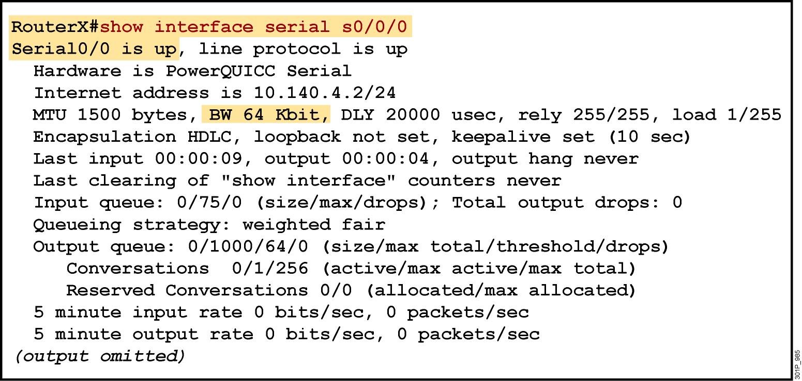
Verifying a Serial Interface Configuration
Notes:
Purpose: This slide shows how to verify the changes you make to an interface.
Emphasize: Notice the bandwidth has been changed to 64K from the default of 1.544M.

Slide 13
Summary
  From the privileged EXEC mode, you can enter the global configuration mode, providing access to other configuration modes such as the interface configuration mode or line configuration mode.
  The main function of a router is to relay packets from one network device to another. To do this, the characteristics of the interfaces through which the packets are received and sent must be defined. Interface characteristics, such as the IP address and bandwidth, are configured using the interface configuration mode.

Slide 14
Summary (Cont.)
  In a TCP/IP environment, end stations communicate seamlessly with servers or other end stations. This communication occurs because each node using the TCP/IP protocol suite has a unique 32-bit logical IP address.
  When the router interface configuration has been completed, it can be verified by using show commands

